Slide 1
Object Oriented Design Patterns Publish and Subscribe
James.Fennell@lit.ie

Slide 2
The Java Enum https://www.tutorialspoint.com/java/java_interfaces.htm
An interface is a reference type in Java
It is similar to class
It is a collection of abstract methods
A class implements an interface, thereby inheriting the abstract methods of the interface
An interface may also contain constants, default methods, static methods, and nested types
Interface method bodies exist only for default methods and static methods
Writing an interface is similar to writing a class
An interface contains behaviours that a class implements
A class describes the attributes and behaviours of an object
Unless the class that implements the interface is abstract, all the methods of the interface need to be defined in the class

Slide 3
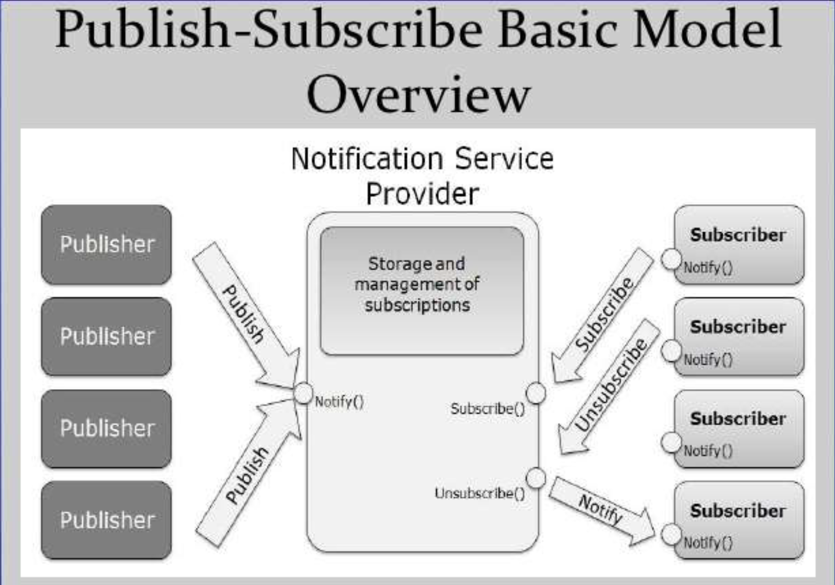
Publish and Subscribe
The PubSub Pattern is an extension of the Observer behavioural Design Pattern
An PubSub allows us to have multiple Subscribers which can receive updates from multiple Publishers
Publishers are not aware of Subscribers and vice versa
The communication between all of these Publishers and Subscribers is controlled by a Notification Service Provider is managed by a Topic

Slide 4
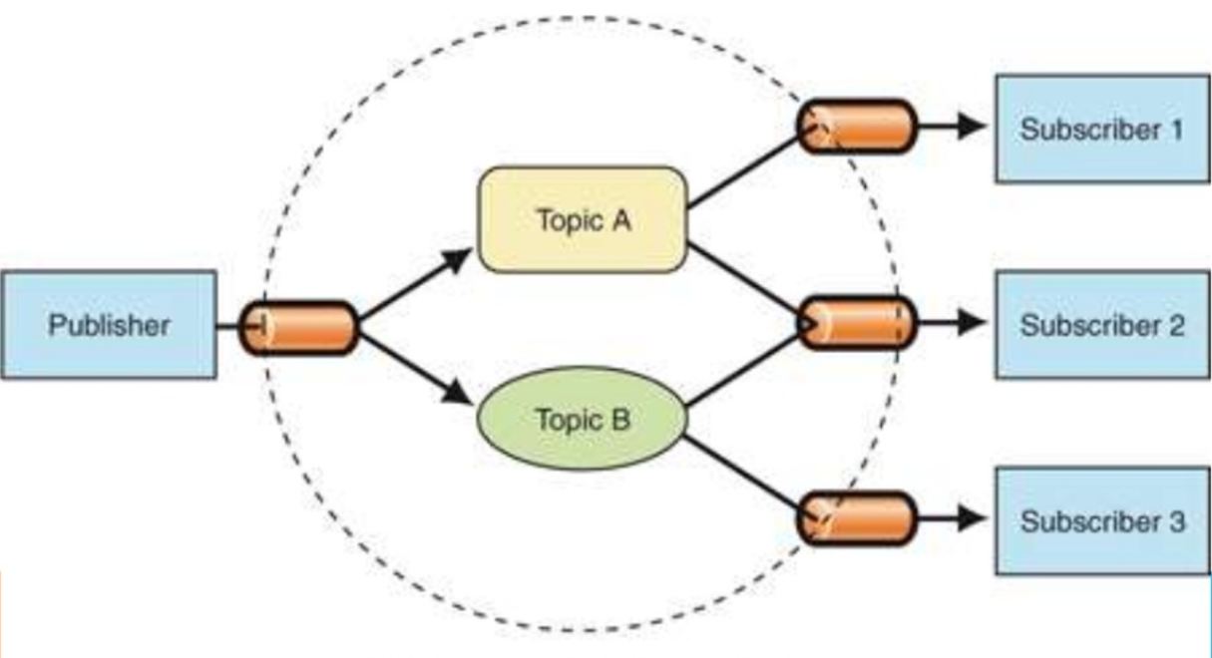
Publish and Subscribe
The PubSub Pattern supports loose coupling as no publisher is aware of any Subscriber and no Subscriber is aware of any publisher
Each object type just “snaps in/out” as appropriate to the available Topics
Publishers and Subscribers can register with as many topics as they wish

Slide 5
Publish and Subscribe Topic vs Content Systems
Subscribers in a topic-based system will receive all messages published to the topics to which they subscribe
All subscribers to a topic will receive the same messages
The publisher is responsible for defining the topic of a message
In a content-based system
messages are only delivered to a subscriber if the attributes or content of those messages match constraints defined by the subscriber
The subscriber is responsible for classifying the messages
Some systems support a hybrid of the two
publishers post messages to a topic
And subscribers register content-based subscriptions to one or more topics

Slide 6
Publish and Subscribe Pros and Cons
Pros | Cons
Loose Coupling | Increased Complexity
Improved Security | Increased Maintenance
Improved Testing | Decrease in Performance?? (Speed)

Slide 7
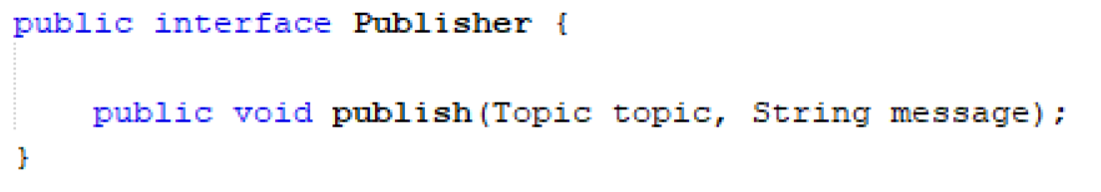
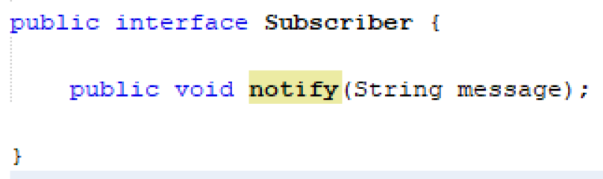
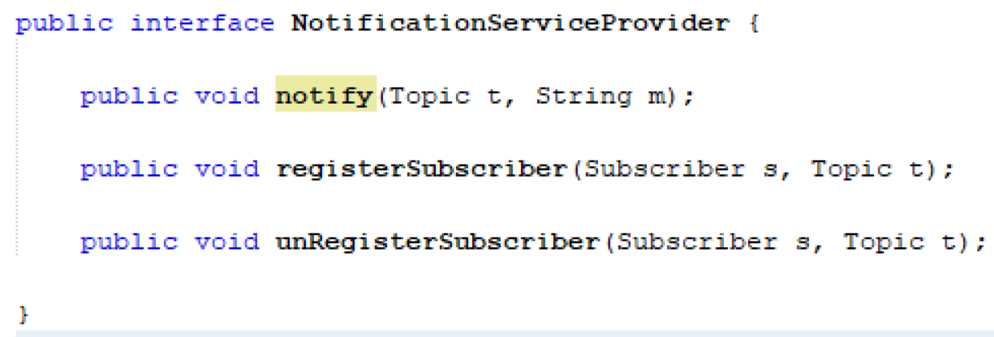
PubSub Example
We have a three object types
Publisher
Subscriber
NotificationServiceProvider
See the Interfaces to the left

Slide 8
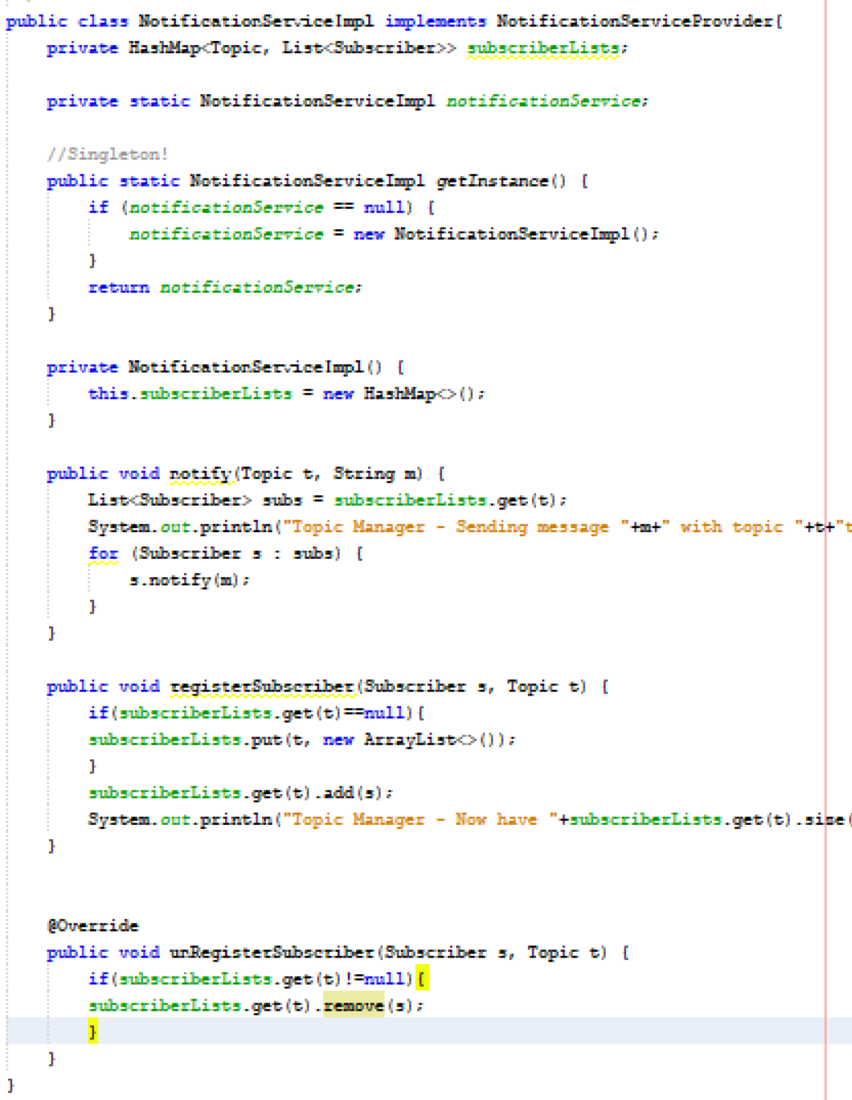
PubSub Example
NotificationServiceImpl
Keep a HashMap of Subscriptions
key => Topic
value => list of Subscribers
I have included some log messages so we can track how the app works

Slide 9
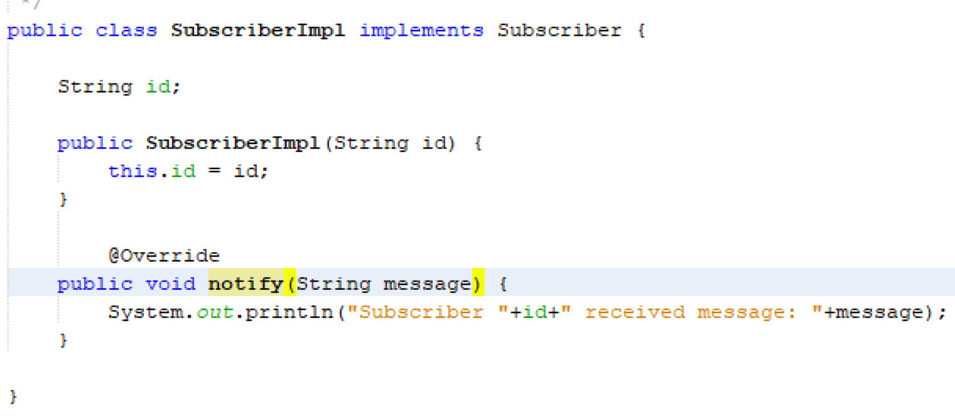
PubSub Example
The Subscriber is more or less identical to the Observer
I have added an identifier to the constructor to help with our logging
You should be able to implement the constructor yourself from the information given

Slide 10
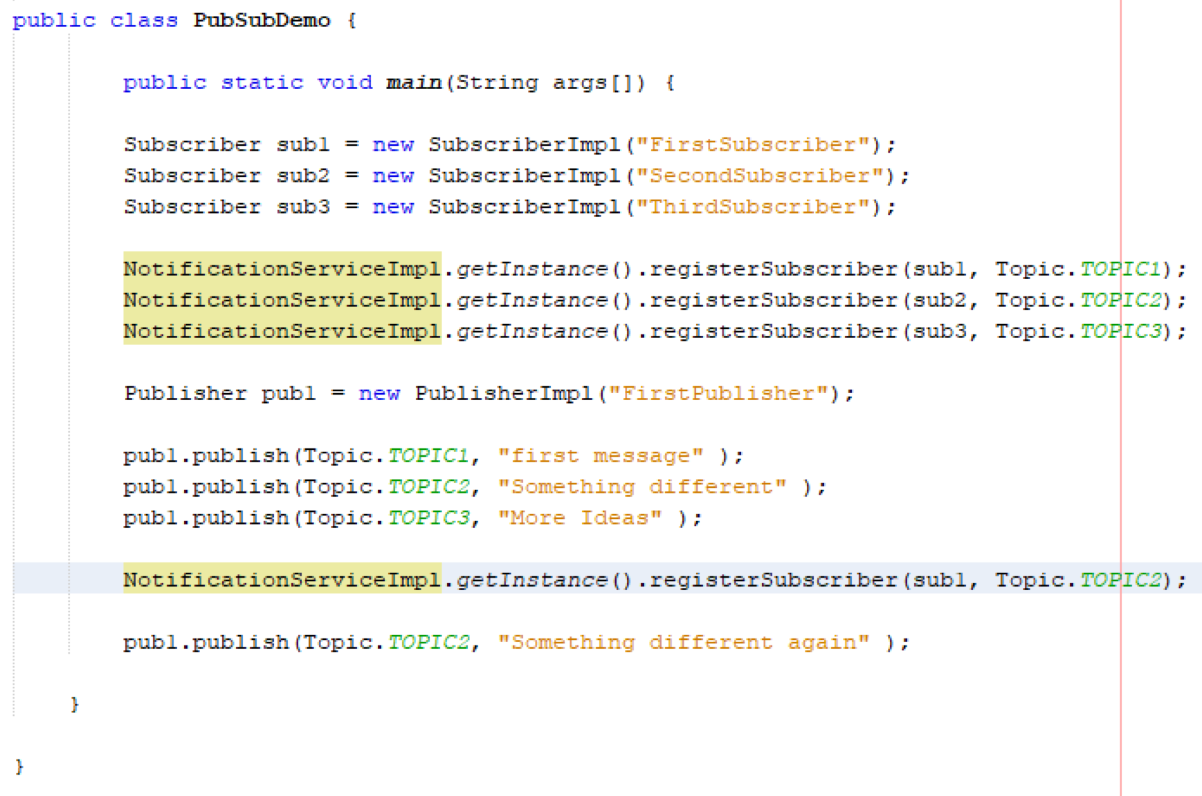
Pub Sub Sample Pull it All together
We create a simple app to demonstrate the PubSub working
Create a 3 Subscribers that will receive updates
Register them on a Topic with the NotificationService
Start generating updates for the Topics

Slide 11
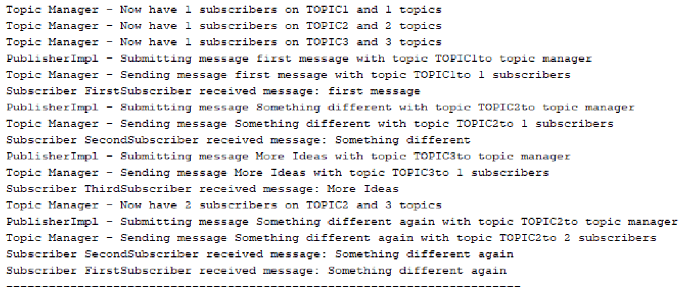
Observer Sample Pull it All together
Run the file
submit some updates
Check the logs

Slide 12


